Slide 1


APPLICATION CHEMISTRY
A2 LEVEL
ANALYTICAL CHEMISTRY
CHAPTER 1: ELECTROPHORESIS

Slide 2
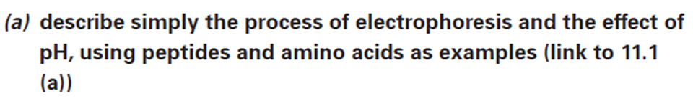
What you should know…

Slide 3
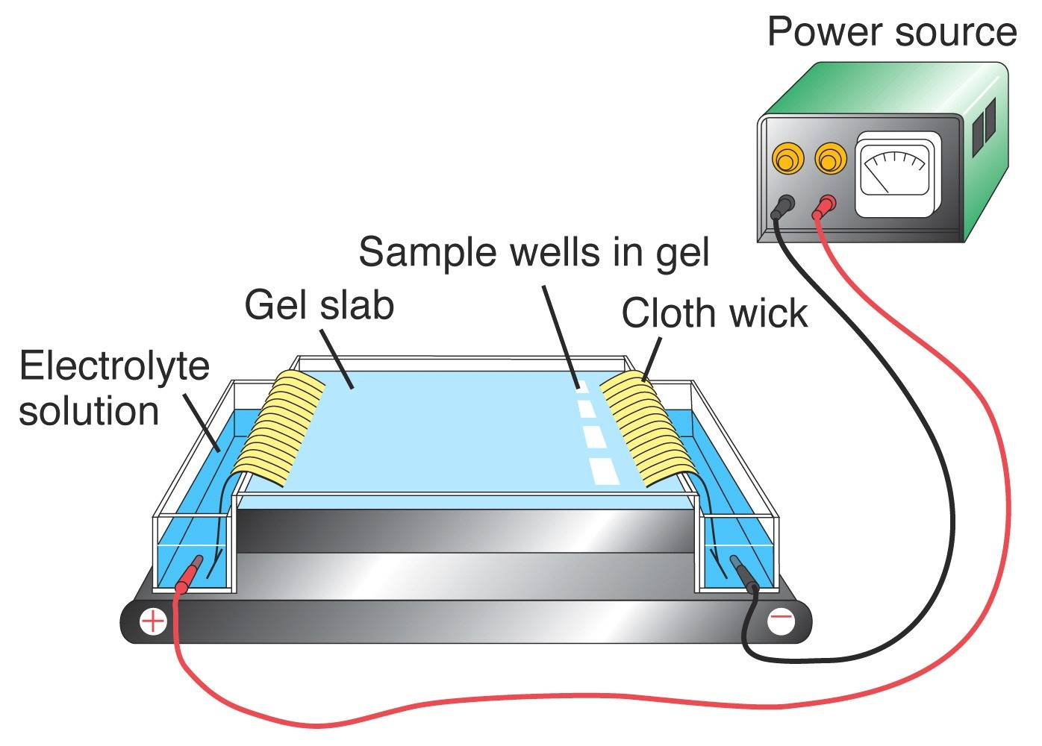
Electrophoresis
The analytical technique on electrophoresis is based on separating ions placed in an electric field.
If a sample is placed between two electrodes, positively charged ions will move towards a negatively charged electrode and negatively charged ions will move towards a positively charged electrode.
The sample is placed on absorbent paper or on a gel supported on a solid base such as a glass plate.
A buffer solution carries the ions along.
The rate of the ion movement is depends on the size and charge.
The larger the ions will move more slowly and highly charged ions will move more quickly.

Slide 4
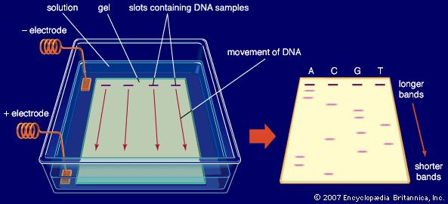
Electrophoresis
The ions are separated as the electric field is applied.
A series of lines or band on the paper or gel are formed ~ electropherogram.
UV light is used to show the bands up.
In gel electrophoresis an electric field is applied to a buffer solution covering an agarose gel, which has slots at one end containing DNA samples. The negatively charged DNA molecules travel through the gel toward a positive electrode and are separated based on size as they advance.
Credit: Encyclopædia Britannica, Inc.
Notes:
An agarose is a polysaccharide polymer material, generally extracted from seaweed.
Agarose is frequently used in molecular biology for the separation of large molecules, especially DNA, by electrophoresis.
Slabs of agarose gels (usually 0.7 - 2%) for electrophoresis are readily prepared by pouring the warm, liquid solution into a mold.
A wide range of different agaroses, of varying molecular weights and properties are commercially available for this purpose.

Slide 5
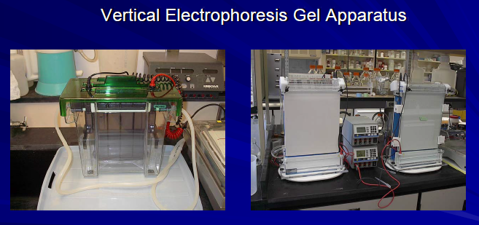
Electrophoresis

Slide 6
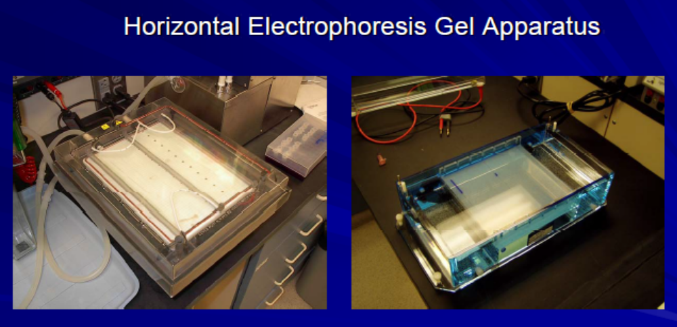
Electrophoresis

Slide 7
Electrophoresis
Electrophoresis there is no mobile phase
Only ions, not neutral molecules, move through the buffer solution along the plate.
Example: The original spot will have been separated into three spots, as in Figure 2.37 & 2.38.

Slide 8
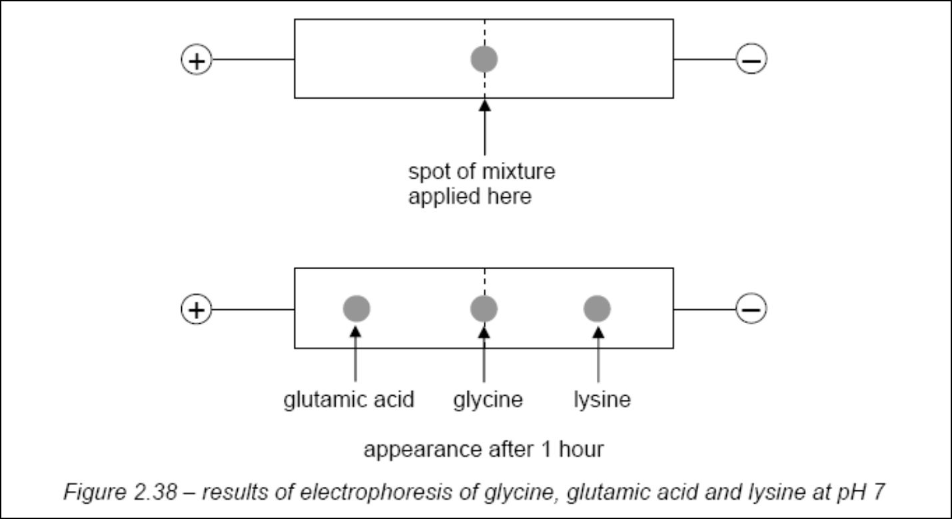
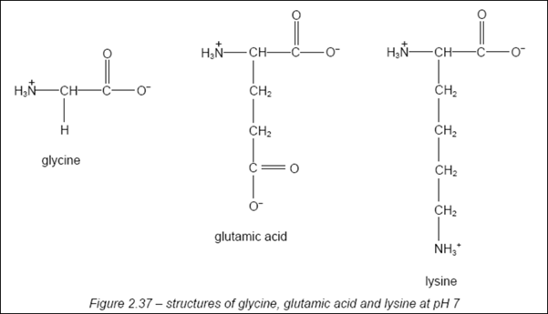

Slide 9
Electrophoresis
In industrial, analytical or research environments, paper electrophoresis – imprecise
Either gel or capillary electrophoresis is employed.
Gel electrophoresis covers a range of techniques that is used to separate, analyse and purify mixtures of biological molecules such as proteins and nucleic acids.

Slide 10
Electrophoresis
These techniques can be adapted to:
  measure the relative masses of macromolecules
  prepare nucleic acids and polypeptides for sequencing the component monomers e.g. purine and pyrimidine bases and amino acids; and
  separate proteins, so antibodies can be raised

Slide 11
Electrophoresis
The sample mixture is placed in a gel.
Separated into its constituents by applying an electric field to the gel, which is soaked in a liquid buffer.
Gel is a sponge-like structure, has the texture of a jelly.
Gels are used because - more chemically stable as a support medium.

Slide 12
Electrophoresis
Components in the sample mixture have an electrical charge.
Nucleic acids like DNA are usually negatively charged (at the phosphate groups in the chain) at the pH used for their separation using electrophoresis.
The molecules move in response to an electrical field applied across the mixture.
The rate of progress of the molecules depends on their size, charge and shape.
On separation, the components are concentrated into bands or zones.

Slide 13
Electrophoresis
Each band or zone can be quantified using a variety of methods.
Using sensitive techniques : bioassays OR silver staining
Has a variety of applications:
  checking the adulteration of foods
  chromosome sequencing
  DNA fingerprinting
  characterising the chemicals responsible for allergic symptoms
  screen infants' milk for α-lactoglobulin, a protein which is lethal for small babies
Notes:
Adulterated food – Impure, unsafe, unwholesome food. It bears or contains a poisonous or deleterious substance which is injurious to health.
Bioassay – are procedures that can determine the concentration or purity or biological activity of a substance such as vitamin, hormone or growth factor by measuring the effect on an organism, tissue, cells, enzyme or receptor.
Siver stain – Is used to detect proteins after electrophoretic separation on polyacrylamide gels (PAGE)

Slide 14
Electrophoresis
The main components used in a gel electrophoresis analysis (see Figure 2.40) are:
  an electrophoresis chamber;
  a gel support medium soaked in conducting buffer;
  a means of generating an electric field –e.g. a power pack;
  probes for detecting and/or measuring the separated molecules; and, if necessary,
  a means of extracting the individual products.

Slide 15
Electrophoresis
The mixture are placed in small wells in the gel medium and when the electric field is applied the components of the mixture separate out.
Rate of migration across the gel becomes constant when the force of attraction between the electrode and the oppositely charged component is equal to the frictional force of the gel medium resisting the motion for that particular species.

Slide 16
Electrophoresis
The relative rates at which components move and therefore the extent to which they separate are influenced by the
  Voltage : the velocity of a molecule is directly proportional to the voltage gradient across the gel.
  Size : smaller molecules migrate quicker than larger molecules carrying the same charge.
  Charge : highly charged ions will move quickly
  Shape : a molecule with lots of side-chains experiences more frictional resistance
  Buffer pH : The extent, and direction, of ionisation depends on the pH of the buffer.
  Temperature : a rise in temperature can speed up electrophoresis

Slide 17
Electrophoresis
If a number of components in a sample have similar electrophoretic mobilities, a complete separation may not be achieved.
Buffer medium or the gel support can be altered.
Two-way electrophoresis in different buffers can often separate components.

Slide 18
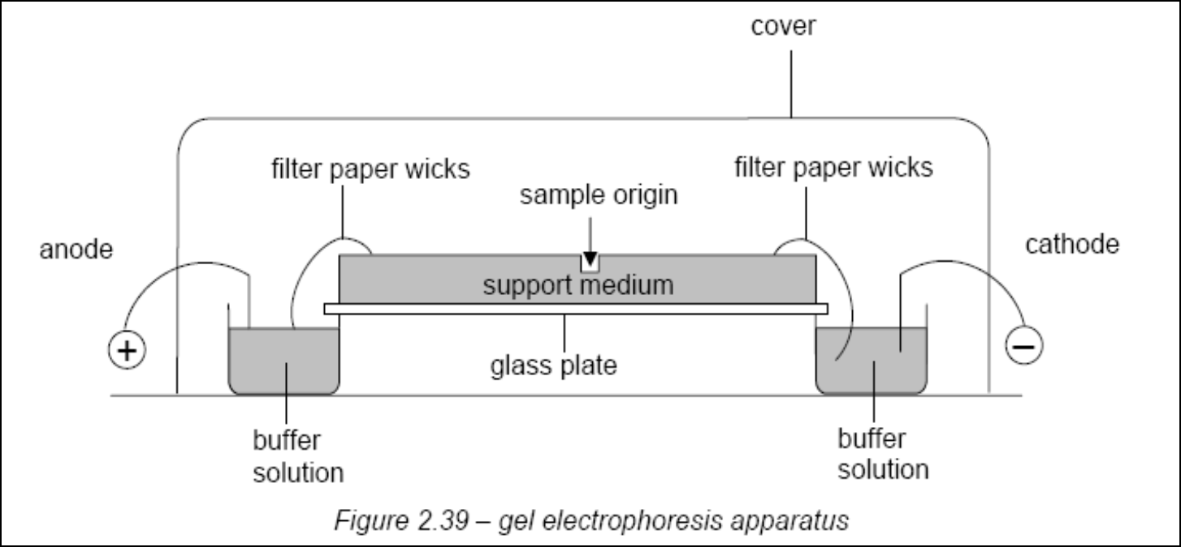
Electrophoresis
Notes:
Continuous system – gel and tank buffers are the same, single phase gel.
Discontinuous system- gel and tank buffer are different, two-phase gel (stacking gel).
A continuous system uses the same buffer for the tank and gel. In continuous systems, molecular charge and gel pore size are the only factors that have any effect on the separation and stacking or concentration of a sample into a band. A concentrated band of sample forms where the molecules are slowed down at the interface of the buffer and the gel. Since smaller molecules have less of a difference between their free solution mobility and their mobility in a gel, the stacking of smaller fragments is not as favorable as it will be in a discontinuous buffer system.
In a discontinuous system, the tank and gel buffers are different from each other. Samples are loaded onto a large-pore gel, called a stacking gel, which overlays a smaller pore resolving gel. The stacking gel serves to concentrate the DNA molecules on top of the resolving gel. After entering the resolving gel, the DNA molecules are separated according to molecular size. The major advantage of a discontinuous buffer system is the increased resolution and concentration of the sample band.

Slide 19
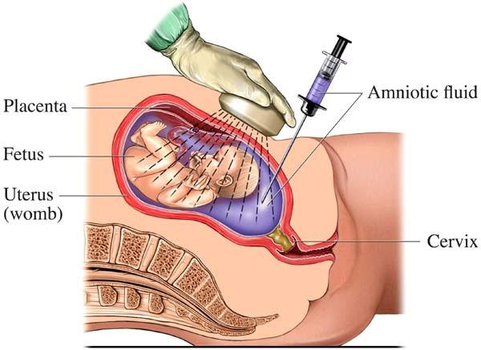
Some medical applications of gel electrophoresis
Defects in newborn babies
Neural tube malformations can be detected from proteins leaking from the central nervous system of a foetus into the amniotic fluid. Analysing these proteins can indicate spinal problems in new-born babies.
Alcohol abuse
Can be investigated by analysing blood. Excess alcohol is associated with changes in acidic proteins and glycoproteins in blood plasma.
‘Fish eye’ disease
Protein samples from people with this condition have been analysed, suggesting that there is a deficiency in an enzyme system associated with lipid metabolism.
Notes:
Fish eye disoder.
Lecithin cholesterol acyltransferase deficiency (LCAT deficiency) is disorder of lipoprotein metabolism.
Lecithin cholesterol acyltransferase catalyzes the formation of cholesterol esters in lipoproteins.

Slide 20
Some medical applications of gel electrophoresis
Heart attacks
Identify more sensitive 'marker' proteins which will indicate early blockage in blood vessels.
Assessing fitness
Serious increase in the amount of protein in urine, which can be detected by two-dimensional electrophoresis.

Slide 21
Other types of electrophoresis
capillary gel electrophoresis
capillary zone electrophoresis
These have found useful applications in:
  the analysis of haemoglobins to identify congenital diseases such as sickle-cell anaemia, thalassemia, and conditions associated with diabetes
  the detection of chemical weapons products – for example, the alkylphosphonates arise from the breakdown of sarin, one of the nerve gases
  detecting gunshot residues on skin and clothing
  detecting drugs by analysis hair samples
  separating milk proteins (see Figure 2.40)

Slide 22
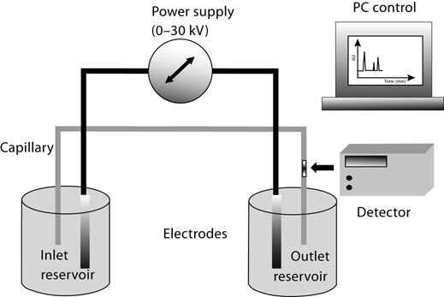
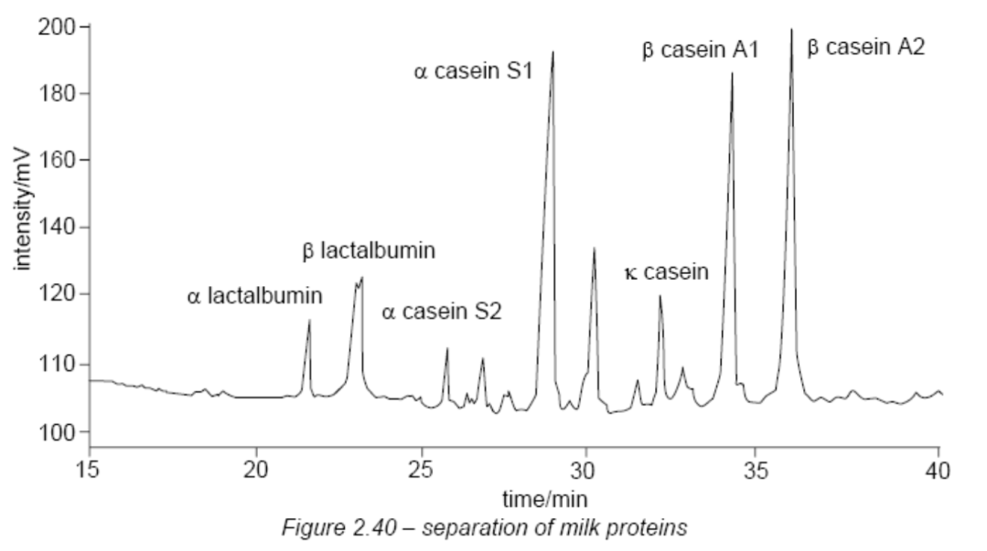
Other types of electrophoresis

